Slide 1
Sprint 1
Team 9

Slide 2
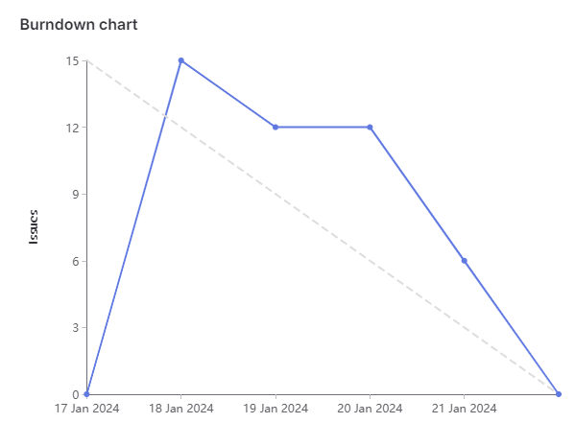
Milestone 1 Chart

Slide 3
Things to Improve:
Things Done Well:
Didn’t have our first meeting till Thursday
Completing entirety of CI/CD for unit testing code
Delegated tasks and completed them in a timely manner
Communicated with team members and arranged meetings for preparations for retrospective
Supported other team members to solve issues i.e., GitLab permissions errors which restricted pushing commits
Documented findings in Readme and CI/CD wiki

Slide 4
Eric
Worked with Egor and Kal on landing page
CI/CD Research and About me
Total Weights: 12

Slide 5
Cavaari Taylor
What I did this week:
CI/CD Research (2)
Design Landing Page (3)
Code About me Page (4)
Update Readme (3)
Challenges Faced:
Time

Slide 6
Muhammad
Total Weights : 12
CI/CD research ( commented on issue) - 2 weights
Readme - 3 weights
About me page design on Figma - 3 weights
About me page - 4 weights

Slide 7
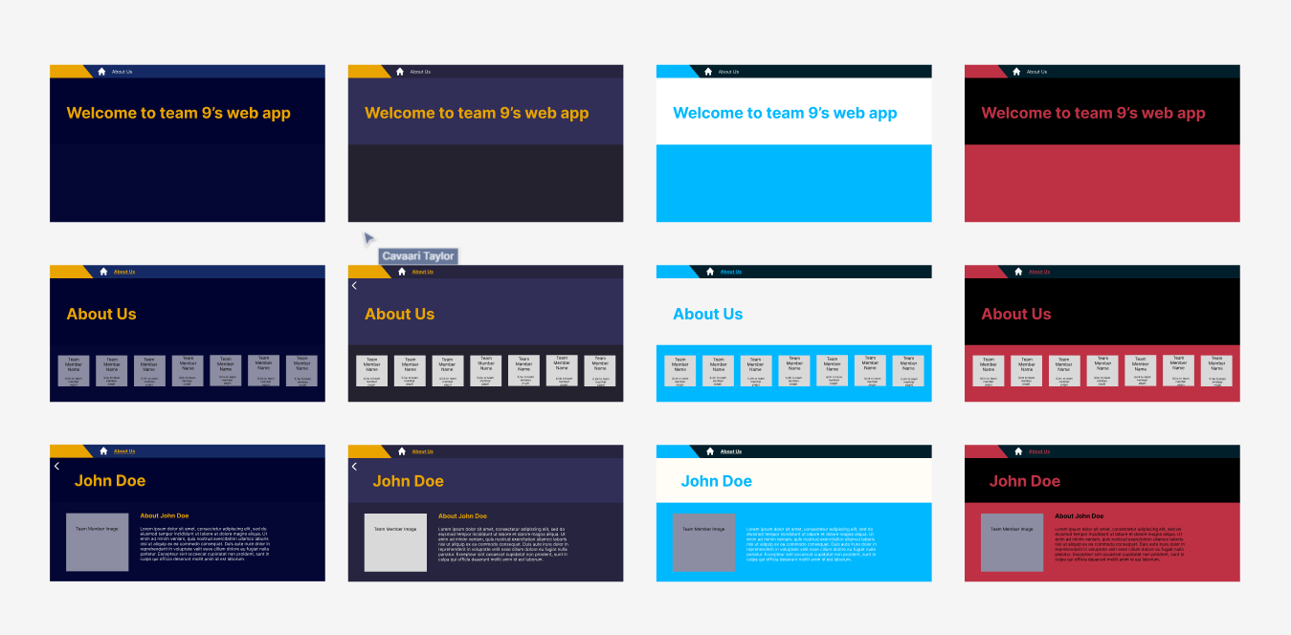
Tehreem - Weight Total : 12
CI/CD Research(2)
About Me(4)
Landing Page Design(3)
About Me Page Design(3)
Challenges:
Forgetting to close tickets earlier

Slide 8
Karina - Weight Total: 12
CI/CD research - 2 weights
CI/CD implementation - 4 weights
Created CI/CD wiki to document specific details on Pipeline
About me page - 4 weights
Set up sprint in git - 2 weights
Challenges
Connection to socs VM through GitLab pipeline for production

Slide 9
Egor
VM Setup + Git Lab(Readme Nginx Guide production environment) - 3
About me - 4
Landing Page(global.css theme, Navbar.php component like Figma Design) - 3
Total: 10 Points

Slide 10
Kalindu
VM setup with Egor
About me page
Landing page (Styling + Navbar)
CI/CD Research
Total weights: 12

